Slide 1

Predicting Fraudulent E-Commerce Transactions
Group 8
Notes:
Our Project Topic is the Analysis of Job Market Trends in the US.

Slide 2

Project Overview
Our project involved two datasets of e-commerce transactions. The smaller dataset (Version 2), which included a binary indicator of fraudulence, was used to train a machine learning model. This trained model was then applied to the larger dataset (Version 1) to predict fraudulent transactions.
The primary goal of this project was to achieve a fraud detection model with a prediction accuracy of 75% or higher. Additionally, the model’s performance was compared to the original dataset’s fraud detection accuracy to evaluate its effectiveness.

Slide 3
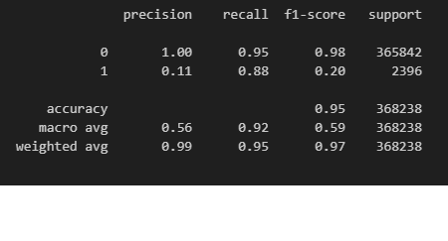
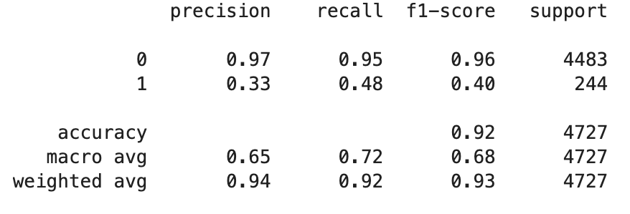
Model Selection: Logistic Regression versus Random Forest with SMOTE
Logistic Regression Model
Random Forest with SMOTE Model
Notes:
Logistic Regression Model: While we were able to achieve higher recall values for Class 1 (fraudulent transactions), there was extremely low precision, meaning it often predicts more false positives, flagging legitimate transactions as fraudulent. This model did not perform well due to the imbalanced dataset.
Random Forest Model with SMOTE: When originally testing the Random Forest model, we were able to attain perfect precision for fraud detection. However, that came at a cost of very low recall and not detecting enough fraud cases. To account for the imbalanced datasets, where the minority class is underrepresented, we incorporated SMOTE with our random forest model.
*SMOTE (Synthetic Minority Oversampling Technique):
SMOTE is a data augmentation technique used to address class imbalance in datasets, especially in machine learning problems. It generates synthetic samples for the minority class by interpolating between existing minority class samples, rather than simply duplicating them. (looking at the 5 nearest neighbors by default)
*If the priority is to detect as many frauds as possible, Logistic Regression is a good model due to the higher recall. However, if the priority is to reduce false positives while maintaining good accuracy, Random Forest with SMOTE appears to be the better option.
*Model selection was based on training and testing on smaller dataset 23k records

Slide 4
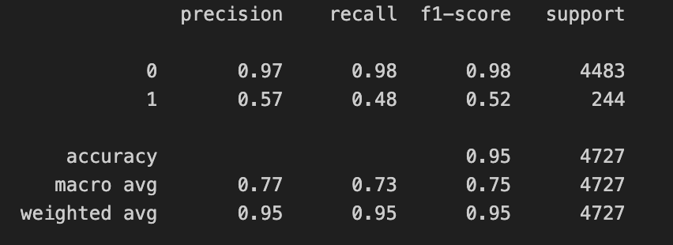
Model Selection: Random Forest with SMOTE versus XGBoost
Random Forest with SMOTE Model
XGBoost Model
Notes:
Random Forest Model with SMOTE: While Random Forest with SMOTE did a better job with precision than the logistic regression, precision was still on the low end, leading to more false positives.
XGBoost Model: The XGBoost model significantly outperformed the Random Forest model with SMOTE in precision (57% versus 33%), with fewer false positives. While recall remained the same (48%), XGBoost achieved a better balance between precision and recall, with better performance in overall accuracy and in handling the imbalanced dataset.
*XGBoost (Extreme Gradient Boosting):
XGBoost is a gradient-boosting algorithm designed for optimized performance and speed. It sequentially builds decision trees, correcting errors made by previous trees. Instead of using SMOTE, XGBoost addresses class imbalance through its scale_pos_weight parameter, which adjusts the importance of the minority class.
*Model selection was based on training and testing on smaller dataset 23k records

Slide 5
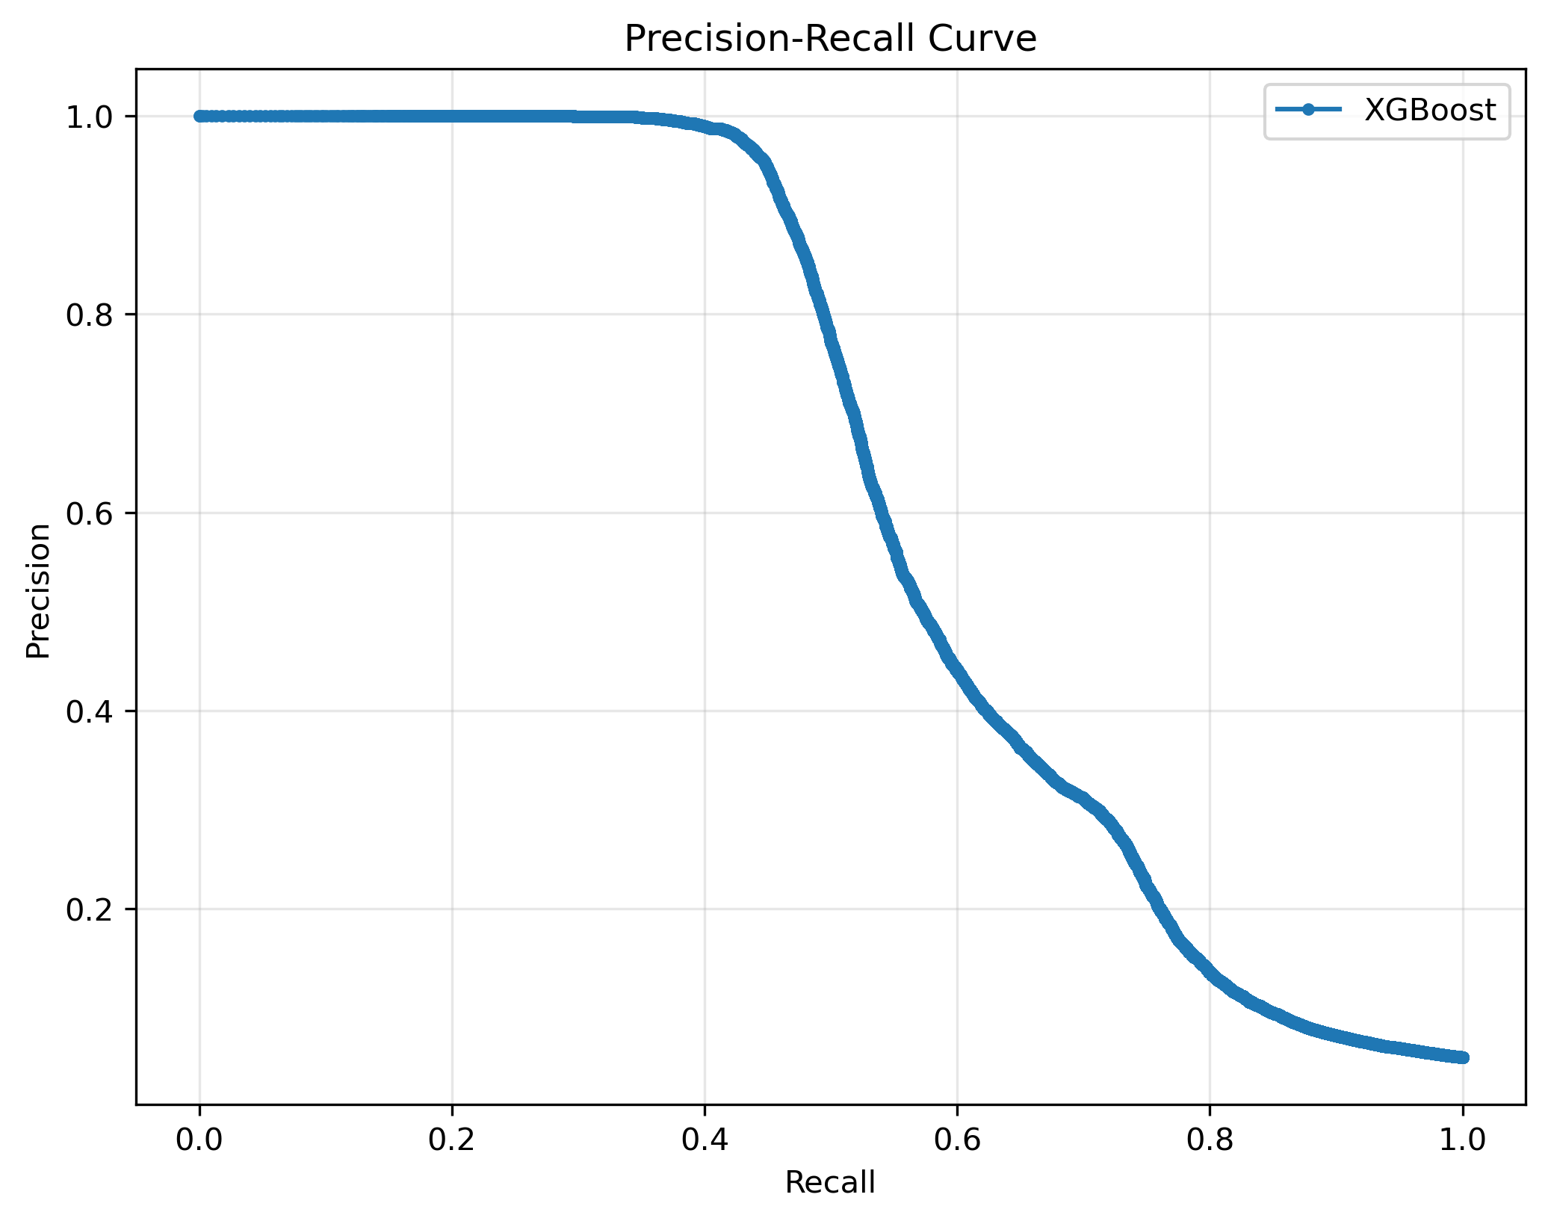
Precision-Recall Curve with XGBoost
Notes:
1. High Precision at Low Recall:
On the left side of the curve, the precision is close to 1.0 when recall is very low. This indicates that when the model predicts very few transactions as fraudulent, it is mostly correct (fewer false positives). However, it is missing a lot of actual fraudulent transactions.
2. Trade-Off:
As recall increases (moving right along the x-axis), the precision decreases. This is because, to catch more fraudulent transactions, the model starts predicting more transactions as fraudulent, which increases false positives.
3. Model Performance:
The area under the curve gives a sense of how well the model performs. If the curve stays high (closer to 1.0), it indicates that the model maintains a good balance between precision and recall. A steep drop-off in precision as recall increases may indicate a trade-off between identifying true positives and avoiding false positives.
4. Application-Specific Decision:
Depending on the use case, you might prioritize precision (e.g., to minimize false alarms in fraud detection systems where false positives are costly) or recall (e.g., to ensure all fraudulent transactions are flagged).

Slide 6
Analysis & Conclusion
While the model performs well overall (95% accuracy), its ability to detect fraudulent transactions specifically (Class 1 metrics) falls short of the target. The highest F1-Score we were able to achieve for Class 1 using our XGBoost model was 52% of the 75% or more goal.

Slide 7

Thank you

